Slide 1
Multi-View Discriminant Analysis 多视判别分析
阚美娜
中国科学院计算技术研究所
kanmeina@ict.ac.cn

Slide 2
Outline
Motivation
Multi-view Discriminant Analysis (MvDA)
Experiments
Conclusions
[1] Meina Kan, Shiguang Shan, Haihong Zhang, Shihong Lao, Xilin Chen. Multi-view Discriminant Analysis. European Conference on Computer Vision (ECCV), 2012.
[2] Meina Kan, Shiguang Shan,Haihong Zhang, Shihong Lao, and Xilin Chen. Multi- view Discriminant Analysis. IEEE Transactions on Pattern Analysis and Machine Intelligence (TPAMI), 2015.

Slide 3
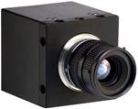
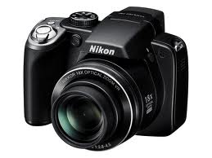
Cross-view/Heterogeneous Recognition
Problem: matching between views
Subjects→heterogeneous sensors→heterogeneous images
Challenge: Large Discrepancy between views
Different pose, lighting, resolution, feature….
View 1
…
View 2
…
View 3

Slide 4
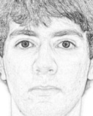
Cross-view/Heterogeneous Recognition
Problem: matching between views
Subjects→heterogeneous sensors→heterogeneous images
Challenge: Large Discrepancy between views
Different pose, lighting, resolution, feature….
vs.
vs.
vs.

Slide 5
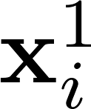
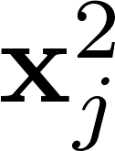
Existing Solutions
Problem & Challenge
Problem:
z: subjects
x: observation
superscript: view

Slide 6
Existing Solutions
Problem & Challenge
Problem:
z: subjects
x: observation
superscript: view
Goal:

Slide 7
Existing Solutions
Project two or more views to a common subspace
Canonical Correlation Analysis (CCA) [H. Hotelling 1936]
Partial Least Square (PLS) [A. Sharma 11]
Multi-view Canonical Correlation Analysis (MCCA) [J. Rupnik 10]
Common Discriminant Feature Extraction (CDFE) [D. Lin 06]
Coupled Spectral Regression (CSR) [Z. Lei 09]
Generalized Multi-view Analysis (GMA) [A. Sharma 12]
Transform from one view
Pseudo-Sketch Synthesis [Q. Liu 05]
Unsupervised vs. Supervised
Two-view vs. Multi-view
Notes:
CCA [H. Hotelling 1936]：最大化两个视图间correlation
MCCA [J. Rupnik 10] ：最大化所有视图间correlation
CDFE [D. Lin 06] ：利用视图之间的判别性信息
CSR [Z. Lei 09] ： Label当做共同子空间
PLS [A. Sharma 11] ： Partial Least Square
GMA [A. Sharma 12] ： Generalized Multi-view Analysis

Slide 8
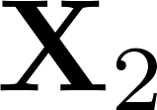
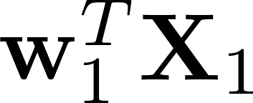
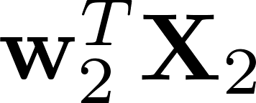
Existing Solutions
Unsupervised Methods
Canonical Correlation Analysis (CCA) ^{[Hotelling 1936]}
=

Slide 9
Existing Solutions
Unsupervised Methods
Canonical Correlation Analysis (CCA) ^{[Hotelling 1936]}
=

Slide 10
Existing Solutions
Unsupervised Methods
Canonical Correlation Analysis (CCA) ^{[Hotelling 1936]}
Supervised Methods
Generalized Multiview Analysis (GMA) ^{[Sharma 2012]}
CCA:
GMA:

Slide 11
Existing Solutions
Unsupervised Methods
Canonical Correlation Analysis (CCA) ^{[Hotelling 1936]}
Supervised Methods
Generalized Multiview Analysis (GMA) ^{[Sharma 2012]}
CCA, unsupervised
CDFE, supervised
GMA, supervised

Slide 12
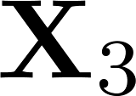
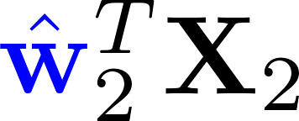
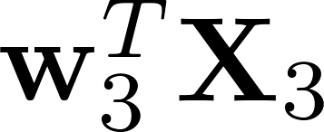
Existing Solutions
Multi-view Methods via pair-wise strategy
Multiple common subspaces

Slide 13
Existing Solutions
Multi-view Methods
Single common subspace

Slide 14
Existing Solutions
Multi-view Methods
Unsupervised: MCCA^{[Nielsen 2002]}
Supervised: GMA^{[Sharma 2012]}
MCCA:
GMA:

Slide 15
Existing Solutions
Multi-view Methods
Unsupervised: MCCA^{[Nielsen 2002]}
Supervised: GMA^{[Sharma 2012]}
MCCA:
GMA:

Slide 16
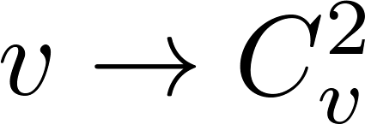
Existing Solutions vs. Ours
Limitations
Pair-wise strategy for multi-view
, many parameters, terms, etc
Discriminancy only from intra-view or inter-view
CDFE & GMA

Slide 17
Existing Solutions vs. Ours
Limitations
Pair-wise strategy for multi-view
, many parameters, terms, etc
Discriminancy only from intra-view or inter-view
CDFE & GMA
Ours

Slide 18
Multi-view Discriminant Analysis (MvDA)
Basic Idea
Project all views into one common subspace
Discriminancy from both intra-view & inter-view
$$w_{1}^{T}x_{i1k}$$
$$⇓$$
$$y_{i1k}$$
$$w_{2}^{T}x_{i2k}$$
$$⇓$$
$$y_{i2k}$$
$$w_{3}^{T}x_{i3k}$$
$$⇓$$
$$y_{i3k}$$
Discriminant Common Space
Class 1
Class 2
. . .
Class c

Slide 19
Multi-view Discriminant Analysis (MvDA)
Basic Idea
Project all views into one common subspace
Discriminancy from both intra-view & inter-view
Project each view to the common subspace
$$w_{1}^{T}x_{i1k}$$
$$⇓$$
$$y_{i1k}$$
$$w_{2}^{T}x_{i2k}$$
$$⇓$$
$$y_{i2k}$$
$$w_{3}^{T}x_{i3k}$$
$$⇓$$
$$y_{i3k}$$
Discriminant Common Space
Class 1
Class 2
. . .
Class c

Slide 20
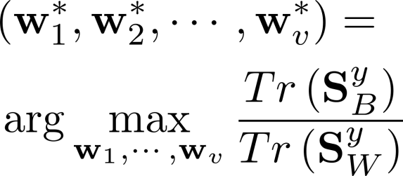
Multi-view Discriminant Analysis (MvDA)
Basic Idea
Project all views into one common subspace
Discriminancy from both intra-view & inter-view
Project each view to the common subspace
$$w_{1}^{T}x_{i1k}$$
$$⇓$$
$$y_{i1k}$$
$$w_{2}^{T}x_{i2k}$$
$$⇓$$
$$y_{i2k}$$
$$w_{3}^{T}x_{i3k}$$
$$⇓$$
$$y_{i3k}$$
Discriminancy of all views in common space
Discriminant Common Space
Class 1
Class 2
. . .
Class c

Slide 21
Multi-view Discriminant Analysis (MvDA)
Basic Idea
Project all views into one common subspace
Discriminancy from both intra-view & inter-view
Project each view to the common subspace
Discriminancy of all views in common space

Slide 22
Multi-view Discriminant Analysis (MvDA)
Basic Idea
Project all views into one common subspace
Discriminancy from both intra-view & inter-view
Project each view to the common subspace
Discriminancy of all views in common space

Slide 23
Multi-view Discriminant Analysis (MvDA)
Formulation
Project each view to the common subspace
Discriminancy of all views in common space
Advantages
Unified framework for multi-view
More discriminancy: intra-view & inter-view
No parameter

Slide 24
Multi-view Discriminant Analysis (MvDA)
Analytical Solution of MvDA
The within-class scatter matrix can be reformulated as follows:

Slide 25
Multi-view Discriminant Analysis (MvDA)
Analytical Solution of MvDA
The between-class scatter matrix can be reformulated as follows:

Slide 26
Multi-view Discriminant Analysis (MvDA)
Analytical Solution of MvDA
The objective of the MvDA can be reformulated as:
which can be reformulated as a more tractable form:
can be solved by resorting to the generalized eigenvalue decomposition

Slide 27
MvDA with View-consistency
Extension: view-consistency (VC-MvDA)
Consistency in kernel space → primary space
Representer
Theorem

Slide 28
MvDA with View-consistency
Extension: view-consistency (VC-MvDA)
Structures of two views are same or similar
Representer Theorem:
…
…
Projection of samples:
…
…
View Structure Consistency:
View 1
View 2

Slide 29
MvDA with View-consistency
Extension: view-consistency (VC-MvDA)
Structures of two views are same or similar

Slide 30
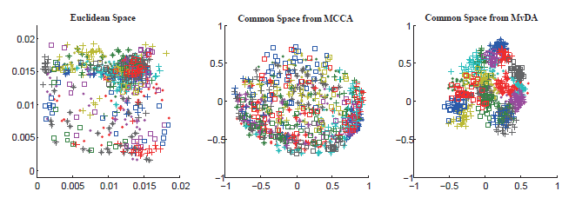
Multi-view Discriminant Analysis (MvDA)
Visualization of the common space
The 2D embeddings of Euclidean space, common space from MCCA and MvDA for the samples from 7 views on Multi-PIE dataset. Different classes are denoted in different colors and shapes.

Slide 31
Multi-view Discriminant Analysis (MvDA)
Experiments
MutliPIE: 7 poses
CCA | FLD | CDFE | U-FLD | GMA | MvDA | VC-MvDA
82.1% | 89.0% | 88.8% | 84.3% | 92.0% | 95.0% | 96.3%

Slide 32
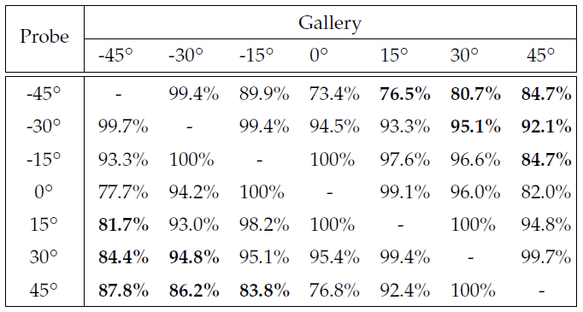
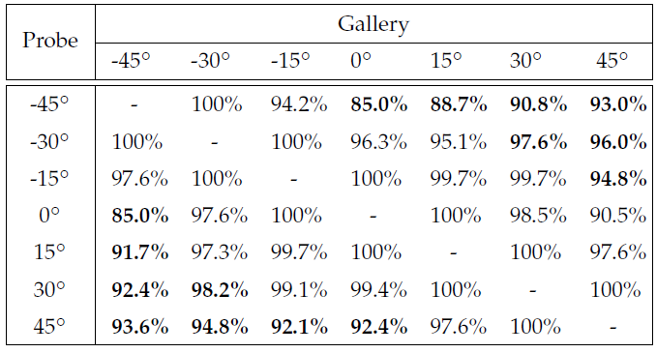
Multi-view Discriminant Analysis (MvDA)
Experiments
MutliPIE: 7 poses
CCA | FLD | CDFE | U-FLD | GMA | MvDA | VC-MvDA
82.1% | 89.0% | 88.8% | 84.3% | 92.0% | 95.0% | 96.3%

Slide 33
Multi-view Discriminant Analysis (MvDA)
Experiments
MutliPIE: 7 poses
CCA | FLD | CDFE | U-FLD | GMA | MvDA | VC-MvDA
82.1% | 89.0% | 88.8% | 84.3% | 92.0% | 95.0% | 96.3%
 | -45° | -30° | -15° | 0° | 15° | 30° | 45°
-45° | - | 1% | 4% | 12% | 12% | 10% | 8%
-30° | 0% | - | 1% | 2% | 2% | 3% | 4%
-15° | 4% | 0% | - | 0% | 2% | 3% | 10%
0° | 7% | 3% | 0% | - | 1% | 3% | 9%
15° | 10% | 4% | 2% | 0% | - | 0% | 3%
30° | 8% | 3% | 4% | 4% | 1% | - | 0%
45° | 6% | 9% | 8% | 16% | 5% | 0% | -
Improvement of VC-MvDA compared to GMA

Slide 34
Multi-view Discriminant Analysis (MvDA)
Experiments
Methods |  | CCA | U-FLD | CDFE | GMA | MvDA | VC-MvDA
HFB | NIR-VIS | 36.7% | 39.1% | 40.8% | 47.5% | 53.3% | 59.2%
 | VIS-NIR | 30.0% | 40.0% | 36.7% | 45.0% | 50.0% | 59.2%
Methods |  | CCA | U-FLD | CDFE | GMA | MvDA | VC-MvDA
CUFSF | Photo-Sketch | 45.5% | 46.8% | 45.6% | - | 53.4% | 56.3%
 | Sketch-Photo | 47.5% | 53.4% | 47.6% | - | 55.5% | 61.5%

Slide 35
Multi-view Discriminant Analysis (MvDA)
Summary
A unified framework for multi-view
Multi-view strategy for both projection and objective
Variations from both inter-view and intra-view
No parameter for MvDA, one parameter for VC-MvDA
Analytical solution
Much better performance

Slide 36
Code
Thanks !
Matlab Code is available online!
http://vipl.ict.ac.cn/members/mnkan

